Slide 1
Clean Code
Boston University CS 506 - Lance Galletti

Slide 2
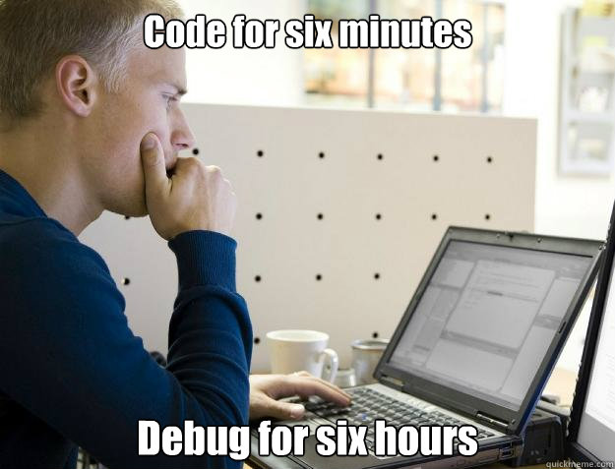
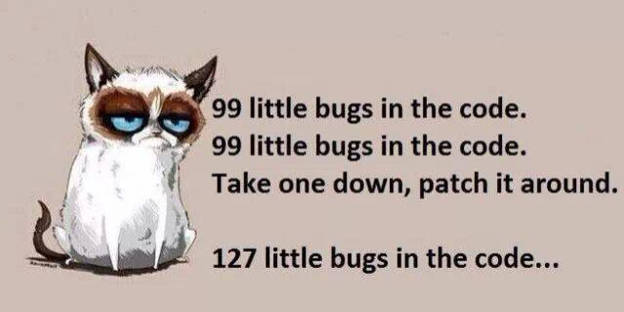
The Problem

Slide 3

The Problem
“Software Systems get replaced not when they wear out but when they crumble under their own weight because they have become too complex”

Slide 4
Why Does this Occur?
english words + grammar != poetry
Need analysis of the code itself - not just algorithms

Slide 5
Gems of Clean Code
Structure
Before writing code ask “How will someone use this (or part of this) code?”. Minimize side effects
Do one thing
Method
Top Down Approach
Bottom up Approach
Solve the problem first - then improve / refine
General
Boring code is good code: keep it simple
Late Binding: start vague and refine (don’t commit to specificity)
Many functions with small bodies > one function with large body
Check soundness by reading your code before testing

Slide 6
Clean Code
'Clean code' by Robert C. Martin
Github Gist Summary of the Book: https://gist.github.com/wojteklu/73c6914cc446146b8b533c0988cf8d29

Slide 7

A Look into Functional Programming
“Functional Programs are mathematical expressions that are evaluated and reasoned about much like ordinary mathematical functions. As a result, these expressions are simple to analyze and compose for large-scale programs”
Combinators on Lists
An example coding exercise

Slide 8
Combinators on Lists
xs = [1, 4, 9, 16, 25]
map( xs, lam(x) => f(x) ) = [ f(1), f(4), f(9), f(16), f(25)]
Ex:
map( xs, lam(x) => x % 2 ) = [1, 0, 1, 0, 1]
Foldleft - idea of consuming the list via an accumulator
Ex:
foldleft( xs, init, lam(x, acc) => f(x, acc) )
foldleft( xs, 0, lam(x, acc) => x + acc )
Acc = 0
Acc = 0 + 1 = 1
Acc = 1 + 4 = 5
Acc = 5 + 9 = 14
Acc = 14 + 16 = 30
Acc = 30 + 25 = 55
Return 55
acc = init
acc = f(1, acc)
acc = f(4, acc)
acc = f(9, acc)
acc = f(16, acc)
acc = f(25, acc)
Return acc

Slide 9
Combinators on Lists
xs = [1, 4, 9, 16, 25] ys = [1, 2, 3, 4, 5]
map2( xs, ys, lam(x, y) => f(x, y) ) = [ f(1, 1), f(4, 2), f(9, 3), f(16, 4), f(25, 5) ]
Ex:
map2( xs, ys, lam(x, y) => x * y ) = [ 1, 8, 27, 64, 125 ]
Foldleft2 - consume both lists (like foldleft on zip)
Ex: foldleft2( xs, ys, 1, lam(x, y, acc) => acc * (x / y) )
acc = 1
acc = 1 * (1 / 1) = 1
acc = 1 * (4 / 2) = 2
acc = 2 * (9 / 3) = 6
acc = 6 * (16 / 4) = 24
acc = 24 * (25 / 5) = 120
Return 120

Slide 10
Example: Max Path Sum
Starting at the top of the triangle and moving down to adjacent numbers below: Find the path from the root to a leaf with the maximum sum.
3
7 4
2 4 6
8 5 9 3

Slide 11
Example: Max Path Sum
Starting at the top of the triangle and moving down to adjacent numbers below: Find the path from the root to a leaf with the maximum sum.
3
7 4
2 4 6
8 5 9 3

Slide 12
Example: Max Path Sum
Starting at the top of the triangle and moving down to adjacent numbers below: Find the path from the root to a leaf with the maximum sum.
3
7 4
2 4 6
8 5 9 3

Slide 13
Example: Max Path Sum
Starting at the top of the triangle and moving down to adjacent numbers below: Find the path from the root to a leaf with the maximum sum.
3
7 4
2 4 6
8 5 9 3

Slide 14
Example: Max Path Sum
Starting at the top of the triangle and moving down to adjacent numbers below: Find the path from the root to a leaf with the maximum sum.
3
7 4
2 4 6
8 5 9 3

Slide 15
Example: Max Path Sum
Starting at the top of the triangle and moving down to adjacent numbers below: Find the path from the root to a leaf with the maximum sum.
3
7 4
2 4 6
8 5 9 3
In the above example the max path sum in 3 + 7 + 4 + 9 = 23

Slide 16
Example: Max Path Sum
Starting at the top of the triangle and moving down to adjacent numbers below: Find the path from the root to a leaf with the maximum sum.
3
7 4
2 4 6
8 5 9 3
In the above example the max path sum in 3 + 7 + 4 + 9 = 23
Brute Force: Find all paths and get the max.
Source: https://projecteuler.net/problem=18

Slide 17
Example: Max Path Sum
Our Algorithm
10 7
2 4 6
8 5 9 3
12 14 13
8 5 9 3
3
7 4
2 4 6
8 5 9 3
20 19 23 16
+
+
max(
)
= 23
max(10 + 4, 7 + 4)
Notes:
Idea: Fold the triangle onto itself

Slide 18
Code Using Combinators
Triangle = list of lists. Can we use foldleft?
max( foldleft( triangle, [], lam(xs, acc) => myfold(xs, acc) ) )
3
7 4
2 4 6
8 5 9 3

Slide 19
Code Using Combinators
Triangle = list of lists. Can we use foldleft?
max( foldleft( triangle, [], lam(xs, acc) => myfold(xs, acc) ) )
3
7 4
2 4 6
8 5 9 3

Slide 20
Code Using Combinators
Triangle = list of lists. Can we use foldleft?
max( foldleft( triangle, [], lam(xs, acc) => myfold(xs, acc) ) )
3
7 4
2 4 6
8 5 9 3
3 0
7 4
10 4
0 3
7 4
7 7

Slide 21
Code Using Combinators
Triangle = list of lists. Can we use foldleft?
max( foldleft( triangle, [], lam(xs, acc) => myfold(xs, acc) ) )
3
7 4
2 4 6
8 5 9 3
3 0
7 4
10 4
0 3
7 4
7 7
10 7

Slide 22
Code Using Combinators
Triangle = list of lists. Can we use foldleft?
max( foldleft( triangle, [], lam(xs, acc) => myfold(xs, acc) ) )
10 7
2 4 6
8 5 9 3

Slide 23
Code Using Combinators
Triangle = list of lists. Can we use foldleft?
max( foldleft( triangle, [], lam(xs, acc) => myfold(xs, acc) ) )
10 7
2 4 6
8 5 9 3
10 7 0
2 4 6
12 11 6
0 10 7
2 4 6
2 14 13
12 14 13

Slide 24
Code Using Combinators
Triangle = list of lists. Can we use foldleft?
max( foldleft( triangle, [], lam(xs, acc) => myfold(xs, acc) ) )
myfold(xs, acc) :
option1 = map2( [0, acc...], xs, lam(x, y) => x + y )
option2 = map2( [acc…, 0], xs, lam(x, y) => x + y )
return map2( option1, option2, lam(x, y) => if x > y then x else y )

Slide 25
Python Examples
myfolder
├── main.py
└── data.txt
main.py
nums = []
with open("../data.txt", "w+") as f:
lines = f.readlines()
for line in lines:
nums += [int(x) for x in line.split(",")]
print(sum(nums))
data.txt
0,1,2,3,4
What is the output of this code?
Prints “10”
Raises an Error
Prints “0”

Slide 26
Python Examples
class Bank:
def __init__(self, balance):
self.balance = balance
def is_overdrawn(self):
return self.balance < 0
myBank = Bank(100)
if myBank.is_overdrawn :
print("OVERDRAWN")
else:
print("ALL GOOD")
What is the output of this code?
Prints “OVERDRAWN”
Prints “ALL GOOD”
Raises an Error

Slide 27
Python Examples
some_string = "what"
some_dict = {}
for i, some_dict[i] in enumerate(some_string):
i = 10
print(some_dict)
for i in range(4):
print(i)
i = 10
What is the output of this code?
Prints “0”
Prints “0 1 2 3”
Raises an Error
What is the output of this code?
Prints “{}”
Prints “{0: 'w', 1: 'h', 2: 'a', 3: 't'}”
Raises an Error
https://book.pythontips.com/en/latest/enumerate.html

Slide 28
Python Examples
row = [""] * 3 # row i['', '', '']
board = [row] * 3
print(board) # [['', '', ''], ['', '', ''], ['', '', '']]
print(board[0]) # ['', '', '']
print(board[0][0]) # ''
board[0][0] = "X"
print(board)
What is the output of this code?
Prints “[['X', '', ''], ['', '', ''], ['', '', '']]”
Prints “[['', '', ''], ['', '', ''], ['', '', '']]”
Prints “[['X', '', ''], ['X', '', ''], ['X', '', '']]”

Slide 29
Python Examples
funcs = []
results = []
for x in range(3):
def some_func():
return x
funcs.append(some_func)
results.append(some_func()) # note the function call here
funcs_results = [func() for func in funcs]
print(results) # [0,1,2]
print(funcs_results)
What is the output of this code?
Prints “[0,1,2]”
Prints “[2,2,2]”
Prints “[]”
Raises an Error

Slide 30
Python Examples
You can find more such Python examples here [1]
[1] https://github.com/satwikkansal/wtfpython

